Slide 1

2018 Company Update

Slide 2
Soar Technology, Inc.
SoarTech researches how an expanding range of AI technologies applies to an expanding range of government domains and creates spin offs as maturing work generates opportunities beyond government research.
We want to be the best in the world at government-funded, applied AI research in:
Intelligent Training
Unmanned Platforms
Cyberspace Operations
And more
Our quiver of AI approaches includes:
Cognitive architectures
Machine learning
Swarming
Dialogue/Natural Language
Human Computer Symbiosis
And more
Our three business areas are pursuing spinoffs:
SoarAuto has already spun off from Unmanned Platforms
 | Gov’t | Commercial
Research | SoarTech | Spinoff
Non-Research | Spinoff | Spinoff

Slide 3
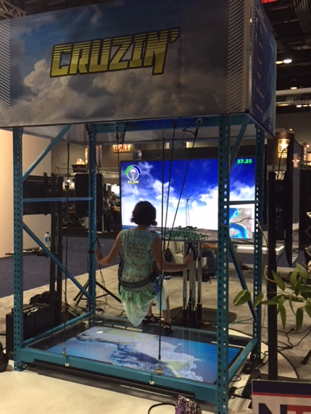
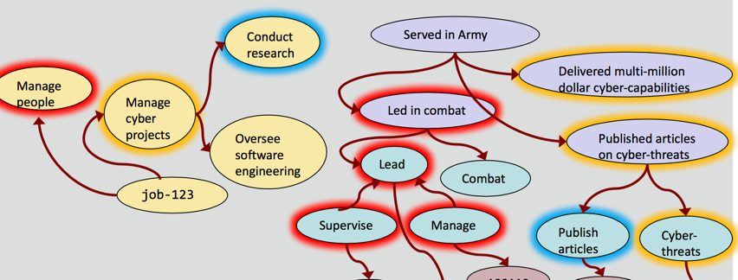
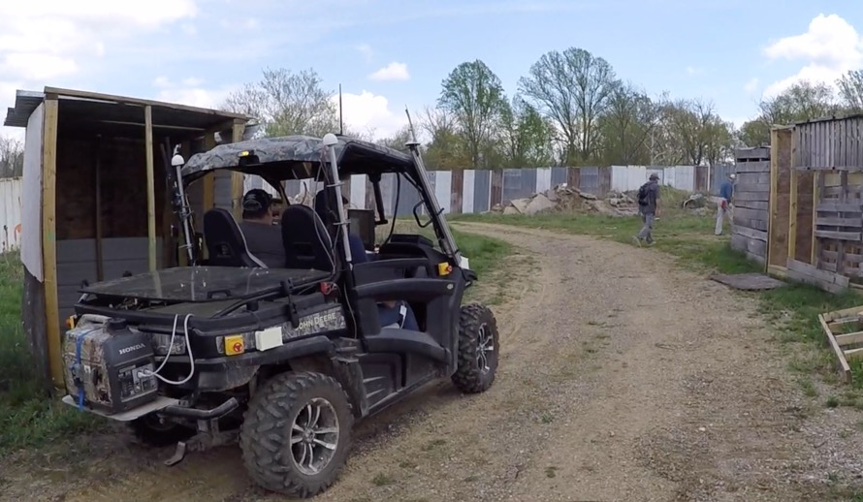
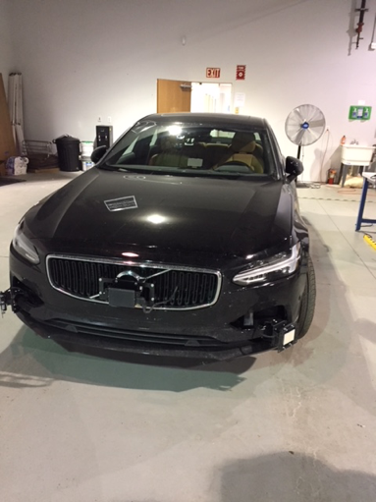
Examples of SoarTech projects

Slide 4
Contributions to the Soar community
New features in cSoar (2014)
jSoar (2015)
Soar Programmer’s Guide (2015)
SoarIDE (2016)
NGS (2017)
Porting Soar to Android (2018)

Slide 5
Nuggets and Coal
Nuggets
More fun coworkers being introduced to Soar
More fun projects, some using Soar
Experienced and new SoarTech engineers/scientists adopting Soar on their terms
Pushing Soar closer and closer to real-world, deployed systems
Rapid growth is a wild ride
Coal
Rapid growth is a wild ride
Need to strengthen ties between SoarTech and U of M AI lab (and Soar group)

